Slide 1

Module Four:
Reflect, Monitor, and Share: Maximizing Student Learning through
One to One Conferencing
Created By The Classroom Diagnostic Tools Core Team
2013–2014
Tom Corbett, Governor
Carolyn Dumaresq, Ed. D
Acting Secretary of Education
Notes:
1
Notes for Trainer:
What’s in This Module?
Classroom Diagnostic Tools (CDT) Pre-Formative Assessment of Current Knowledge
Components of the CDT Cycle
In order to connect educator effectiveness with the CDT, slides specifying the four domains are included. Trainer should be knowledgeable about which elements connect to the CDT.
Various activities are embedded within the PowerPoint
Classroom Diagnostic Tools (CDT) Post-Formative Assessment of Current Knowledge
Look at the current research findings on feedback and assessment;
Clarify the purpose and value of feedback to learners;
Deepen the understanding of types of feedback;
Analyze feedback statements and discuss ways to use the feedback to guide student learning; and
View and discuss the work of Pennsylvania educators in supporting One-to-One Conferencing
Using this Module
You are encouraged to customize any or all portions of this module to meet the needs of your audience. This module is intended to fit into a variety of different professional development settings. Any portion of this module may be modified, reproduced and disseminated without prior permission.
Suggested Module Delivery
Facilitate PowerPoint and activities that are embedded within the PowerPoint. Approximate time – 2 hours.
Facilitator Materials
Laptop to view module PowerPoint (iPad can only be used to access the PowerPoint and is not compatible to view the CDT maps).
Projection Unit
Go to eDIRECT site: https://pa.drcedirect.com. Click on Documents in the left side bar. Under Administration, select Classroom Diagnostic Tools 2013-2014. Under Document Type, dropdown to Professional Development. Find the following:
Module Four: Reflect, Monitor, and Share: Maximizing Student Learning through One-to-One Conferencing
Module 4: Graphic Organizer for Note Taking
Penny for Your Thoughts containers
Word Document on Four Types of Feedback with Examples (Slides 19 and 20 designed on one word document.)
Slides printed: 7 and 9 (Benefits for Students and Teachers); 10 and 11 (pre-formative assessment; and 37 and 38 (teacher and principal domains); and 39 and 40 (post-formative assessment).
One to One Conferencing Booklet
11 large posters for One to One Conferencing Jigsaw Activity. (Activity is in One to One Confererncing booklet.)
Research Mingle Documents – Directions: You will need to prepare a different color for each level of research. Refer to Slide
Hands Up, Pair Up, Share Up!
A - Purple
B - Blue
C – Pink
D - Orange
E – Green
F - Yellow
G – Red
Directions: Talk to as many people in the room as you can.
Try to find partners who have a different research than you do.
Each pair should swap research and read.
Briefly, talk about how your research may be related and implications for feedback. Make “talking to the text” notes as you go.
When time is up, return to your team tables.
Video 1 – Student Tyler Video
Video 2 – Preparing Students – Two Teachers
Video 3 – Emily and Teacher
Video 4 – Helena and Teacher
Video 5 – Tyler and Teacher
Video 6 – Carly and Teacher
Participant Materials
Laptop to view module PowerPoint (iPad can only be used to access the PowerPoint and is not compatible to view the CDT maps). (If needed, participants could share a laptop.)
Each participant will need directions on how to access the PowerPoint.
Copy of the Note Taking Tool for Module Four
Word Document on Four Types of Feedback with Examples (Slides 19 and 20 designed on one word document.)
Slides printed: 7 and 9 (Benefits for Students and Teachers); 10 and 11 (pre-formative assessment; and 37 and 38 (teacher and principal domains); and Slides 39 and 40 (post-formative assessment).
A Penny for Your Thoughts container (small container, maybe labeled A Penny for Your Thoughts, and two pennies for each person for each table)
Highlighters for each table; Small post-its
A copy of One-to-One Conferencing Booklet for each participant (Booklet found on eDIRECT.)
11 large posters for One to One Conferencing Jigsaw Activity. (Activity is in booklet.)

Slide 2
What’s in this Module?
Look at the current research findings on feedback and assessment;
Clarify the purpose and value of feedback to learners;
Deepen the understanding of types of feedback;
Analyze feedback statements and discuss ways to use the feedback to guide student learning; and
View and discuss the work of Pennsylvania educators in supporting One-to-One Conferencing
2
Notes:
Notes for Trainer:
Review.
2

Slide 3
Why should the Classroom Diagnostic Tools be used?
  Benefits for Students:
    Provides specific and timely feedback designed to support student learning.
    Builds efficacy by bringing students into the process of their own learning.
    Promotes goal setting by involving students in the learning process.
    Provides students with opportunities to demonstrate their knowledge and skills.
    Promotes partnering with teachers (e.g., one-on-one conferencing).
    Ensures that follow-up instruction is meaningful and aligns with student learning expectations.
3
Notes:
Notes for Trainer:
Make a copy of this slide for the training. Have the participants highlight the areas that demonstrate key words or phrases that benefit students. Also, encourage participants to highlight areas they want to learn more about.

Slide 4
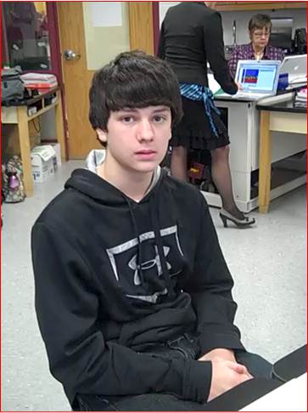
Student Shares His Thoughts Regarding Taking the CDTs
4
Notes:
Notes for Trainer:
Listen to Tyler’s short interview as he explains why he likes taking the Classroom Diagnostic Tools to support his learning.
Go to eDIRECT site: https://pa.drcedirect.com. Click on Documents in the left side bar. Under Administration, select Classroom Diagnostic Tools 2013-2014. Under Document Type, dropdown to Professional Development. Find the following:
Video 1 - Student Video - Tyler

Slide 5
Pre-Formative Assessment on Feedback
That Moves Learning Forward
More Effective | Less Effective | Feedback
 |  | 1. Try harder next time.
 |  | 2. 70%
 |  | 3. Your position paper argues your position, pro and con, on whether or not a gluten-free bakery can be a successful business venture. What implications can be drawn from your potential findings?
 |  | 4. You maintained eye contact with the audience throughout your whole presentation.
 |  | 5. +
 |  | 6. What you have written is a hypothesis because it is a proposed explanation. You can improve it by writing it as an “if…..then….” statement.
 |  | 7. B+ Good Work
 |  | 8. Your performance was strong in tone quality and intonation. You need to work on your rhythm in measures 10 and 14.
 |  | 9. Your work is consistently above average.
5
Notes:
Notes for Trainer:
Print slides 10 and 11. Participants should complete this pre-formative assessment independently. At the end of the session, remind the participants they will take this as a post-assessment.
The participants are only to look at the Feedback examples at this time by reflecting on whether being More Effective or Less Effective.
5

Slide 6
Pre-Formative Assessment on Feedback
That Moves Learning Forward (Continued)
More Effective | Less Effective | Feedback
 |  | 10. You need to do your homework.
 |  | 11. I noticed that you drew other members of the team into the discussion by saying, “Do you agree?”, or “What do you think?”
 |  | 12. You are so close to proficiency. With a little more work, you should be at a level 3.
 |  | 13. You made simple mistakes on your timeline. Make sure your time intervals are all the same length!
 |  | 14. Your thesis statement is clear. Your next step might be to add real details to support it.
 |  | 15. Messy!
 |  | 16. You made some errors on your graph. Go back and check the names of your titles, x-axis, and y-axis.
 |  | 17. Your position paper on Harvesting Rain Water shows technical articles that support the pros on how communities are harvesting drinking water as a resource. Be sure to include evidence that also supports the cons of harvesting drinking water as a resource.
6
Notes:
Notes for Trainer:
The participants are only to look at the Feedback examples at this time by reflecting on whether being More Effective or Less Effective.
6

Slide 7
5 Strategies of Assessment
FOR Learning
Where the learner is going
Clarifying and sharing learning intentions and success criteria (Use examples and models of strong and weak work: Exemplars)
Where the learner is right now
Engineering effective classroom discussions, activities, and tasks that elicit evidence of learning
How to close the gap
3. Activate learners as instructional resources for one another
Activate learners as owners of their own learning
Provide feedback that moves learning forward
(Hattie, 2012)
7
Notes:
Notes for Trainer:
(Research) Read Hattie 2012 recommended strategies of assessment for learning to the audience.
These three big ideas and the strategies below each one moves learning forward.
Where the learning is going.
Teachers need to share the learning intention and the success criteria in order to provide specific feedback in relationship to the learning goal. The students need to know this. William states, “Some kids come to school knowing what good is, but many kids don’t; the learning intention and the success criteria must be clear.” What does the outcome look like? How good is good enough?
Where the learner is right now. Teachers need questions to move learning forward based specifically on the focused learning intention and success criteria.
How to close the gap. A student can be an instructional resource for themselves, or a peer, because they know the learning intention and success criteria.

Slide 8
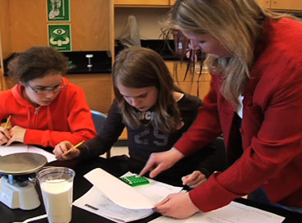
Four Types of Feedback
8
Notes:
Notes for Trainer:
“Let’s go deeper with the four types of feedback!”

Slide 9
Feedback Activity
Where the learner is going
Where the learner is right now
How to close the gap
9
Notes:
Notes for Trainer:
Talking Points for Trainer to Share with the Participants: Depending on the student(s), use of all four types of feedback is critical to move the student forward in the learning. The goal of this work is to ensure we are providing enough descriptive and effective descriptive as quality feedback to learners.
The brain research tells us that our brains require feedback to learn (Pinker, 1997; Sylvester, 1995; Jensen, 1998). Classroom assessment research tells us that when we involve students in the assessment process, increase the amount of descriptive feedback students receive, and decrease the amount of evaluative feedback they receive, students learn significantly more (Black and Wiliam, 1998).
Quality feedback to learners:
focuses on the learning intention of the task – clear target
occurs as the students are doing the learning
provides information on how and why the student understands or misunderstands
provides strategies to help the student to improve
assists the student to understand the goals of the learning.
Activity Directions:
Give each participant a copy of the Four Types of Feedback and Examples document for Module 4.
Have the audience silently read and process the Four Types of Feedback document that includes descriptors and examples.
3. Self reflect using the chart what types of feedback you use most often.
4. Circle the type of feedback where you currently believe you practice, then draw an arrow to the feedback type you want your practice to reflect. Think about how you will get there.
5. Remind the participants they often cross-over between Descriptive and Effective Descriptive Feedback. If this discussion happens, support the discourse and remind the participants the importance of moving forward with not only Motivational and Evaluative Feedback, but the emphasis of moving learning forward with Descriptive and Effective Descriptive Feedback.
6. Now, reflectively write in your Graphic Organizer for Note Taking.

Slide 10
Four Types of Feedback
Motivational | Evaluative | Descriptive | Effective Descriptive
What does this type of Feedback provide? Goal is to make the learner feel good. Intended to encourage and support the learner. Offers no guidance on how to improve the learner’s reasoning. | What does this type of Feedback provide? Measures with a score or a grade. Summarizes student achievement. No guidance on how to improve. Student gets the grade; the learning stops (William, p. 123, 2011) | What does this type of Feedback provide? Tells the learner what steps to take to move forward. Tells the learner what needs to be improved. Gives guidance on how to improve the learners’ reasoning. Makes comments about the strengths and weaknesses of a performance. Makes comments about the work process you observed or recommendations about a work process or study strategy that would help improve the work. | What does this type of Feedback provide? Goal is to internalize the effective feedback. Intended to be used by the learner to independently move his/her reasoning to the next level. Makes comments that position the student as the one who chooses to do the work.
10
Notes:
Notes for Trainer:
Slides 19 and 20 have been kept within the PowerPoint to use for the purposes of a visual display when discussing the Word Document Activity which includes descriptors and examples.

Slide 11
Four Types of Feedback
Motivational | Evaluative | Descriptive | Effective Descriptive
Examples “What powerful words you have used to describe the community! Your words create pictures in the mind of your reader and show what is important to the people who live in this community.” “Your work has definitely improved.“ “I like how you completed the assignment.” “It is obvious you worked hard on this assignment.” “I appreciate the amount of time and energy you are giving this learning task.” | Examples 73% “You’ve shown improvement.” “You need to try harder.” “That’s a good essay.” “ You’ve done well.” “Your report was the shortest one in the class. You didn't put enough in it.” “Your report is late! What's the matter with you?” | Examples “Most of your spelling is accurate. I found only two errors. See if you can find them. Remember the rules for possessives and plurals.” “ I can see that you are stuck on this question. What might help you? You may want to consider a strategy such as rereading the question and underlining key words or by going back to the text to look for evidence. You decide and I’ll check back with you in a bit.” “In your essay you have successfully covered the main points related to energy conservation. What could you add to the section on the water conservation to deepen your reader’s understanding of the issue?” “Your map legend has all of the required key elements needed to identify the geographical landforms. What narrative descriptions could you include to further inform the reader?” “You accurately found the number of students in 4th grade who said ice cream was their favorite. You now need to divide this number by the total number of students to get the percent who said ice cream was their favorite.” | Examples “I know you set the goal to improve your work with estimation strategies in problem-solving situations . How are you doing with the instructional enrichment pieces you chose?” “What a wonderful story of your grandparent’s journey to Canada! Now you need to identify what we can learn from their story about the land, culture and history. Select a graphic organizer to organize and share this information. You might be surprised to see how much good information is in their story!” “I agree with the pattern that you have identified in the table. I am not convinced that the rule you wrote works for all the values in the table. How could you prove this?”
11
Notes:
Notes for Trainer:

Slide 12
Recommendations for
One-to-One Conferencing
2013-2014
Refer to the Recommendations for One-to-One Conferencing with your Students
12
Notes:
Notes for Trainer:
Recommendations for One-to-One Conferences Booklet can be found on eDIRECT. Go to eDIRECT site: https://pa.drcedirect.com. Click on Documents in the left side bar. Under Administration, select Classroom Diagnostic Tools 2013-2014. Under Document Type, dropdown to Professional Development. Find the following: One-to-One Conferencing Booklet 11.26.12
You will need to have one booklet prepared for each participant.

Slide 13
Recommendations for
One-to-One Conferencing
Building Background Knowledge
1. When should one-to-one conferencing take place?
2. When should small group conferencing take place?
3. How will you schedule the conference into your teaching period? How often?
4. Who gets to participate in the conference?
5. What will you discuss?
6. What will you do with the remainder of the students while you are conferencing?
7. How long should a one-to-one conference take?
13
Notes:
Notes for Trainer:
1. Give each participant a copy of the Recommendations for One-to-One Conferencing Booklet.
2. Write each of the 11 questions found on page 4 on large sheets of poster paper and display around the room. Refer to pages Use Around the World/Carousel/Fishbowl. During this activity have participants write their suggestions to the questions on small post-its and place the small post-it on the poster. If you agree with a statement written on a small post-it, recommend to place a check mark on it. Report out. (You may want to add music and stop and start to keep participants on task.)

Slide 14
Recommendations for
One-to-One Conferencing
Building Background Knowledge
8. How will you schedule opportunities for targeted instruction as a result of setting goals from the conference?
9. How will you and your students know they are progressing?
10. Establish questions, such as the following, to ask the student(s) during conferencing:
      When you finished taking the CDT, do you recall an area of need?
      Are there tools, like graphic organizers or manipulatives, you could suggest to me that would help you learn?
      Is there vocabulary you do not understand?
11. Can you suggest other questions?
14
Notes:
Notes for Trainer:
(Questions continued from the previous slide)

Slide 15
Recommendations for
One-to-One Conferencing
Teacher Implementation
Talk to the Text
15
Notes:
Notes for Trainer:
Using the Recommendations for One-to-One Conferencing Booklet, pgs. 5, 6, and 7, implement Teacher Implementation Talk to the Text.
Give participants time to “Talk to the Text” and report out resonating ideas from Teacher implementation of one-to-one conferences to utilize the results provided by the classroom diagnostic tools … and other data.

Slide 16
Recommendations for
One-to-One Conferencing
Tips for a Successful
One-to-One Conference
16
Notes:
Notes for Trainer:
Refer to the Recommendations for One-to-One Conferencing Booklet. Use Random Reporter and have participants read the “Tips for Successful One-to-One Conferencing,” page 9. Solicit discussion.
Keep in mind that this is often a whole new concept for secondary teachers, but often a practice used by elementary teachers. One-to-One conferencing is important for all students, but emphasize that since this is new implementation, begin with small steps.

Slide 17

Preparing Students for
One-to-One Conferencing
17
Notes:
Note for Trainer:
Refer to the One-to-One Conferencing Booklet, page 8. Students need this background information prior to taking the CDT. Teachers will need to facilitate this activity. A specific format for page 8 can be found within Module 3, slides 15 and 16. You will also see these two slides hidden in this Module 4. Hidden slide 27 provides the directions. Hidden slide 28 is the slide you would need to print if you are going to conduct this activity for Module 4.
The title of page 8:
Preparing Students for Classroom Diagnostic Tools
“A Conversation/Activity ‐ Students and Their Teacher(s)”
Suggested Outline for the Teacher(s)
Slides 18 and 19 are hidden for the purposes of reference for the Trainer. If participants have not been through Module 3, you should use these two slides.
When you prepare your students to take the CDT, your students should be able to answer all these questions.

Slide 18
Applying our learning…. Feedback that moves learning forward…
Maximizing Learning through One-to-One Conferencing
“A Walk-Through”
Using the Classroom Diagnostic Tool as the catalyst, let’s watch a few live videos from the Saucon Valley School District located in Hellertown, Pennsylvania. Thanks to teachers, Tori Heffelfinger and Brianne Barona, and their students, and to Stacy Kulics, CDT Core Team Member, and Joana Spinelli, Consultant, both from Colonial IU #20.
18
Notes:
Notes for Trainer:
Before we view a few live One-to-One Conferencing videos, let’s do a quick walk using pages 11-18 of the One-to-One Conferencing booklet. Review the screen shots and the CDT Core Team developed questions that could be posed to the student. These are not to be “cookie cutter” questions to be used for every student, but to be reviewed as advising questions to ask of students. You may want the content area teachers just to review the pages pertinent to their content. Report out after a 5 minute review. What did you notice? What are other questions you may want to ask? You may want to have them write on their graphic organizer.

Slide 19
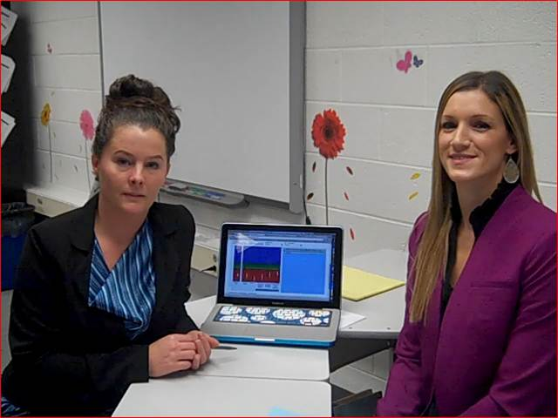
Teachers Share Techniques for
One-to-One Conferencing
19
Notes:
Notes for Trainer:
Go to Go to eDIRECT site: https://pa.drcedirect.com. Click on Documents in the left side bar. Under Administration, select Classroom Diagnostic Tools 2013-2014. Under Document Type, dropdown to Professional Development. Find the following:
Video 2 - Preparing Students - Two Teachers
Remind participants to take notes on the Graphic Organizer for Note Taking.
You may want to share out what these two teachers facilitated in order to prepare their students to take the CDT, and how they prepared for One-to-One Conferencing.

Slide 20
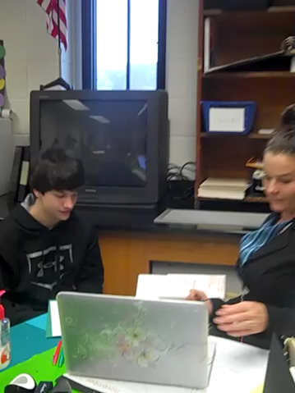
Teacher and Student One-to-One Conferencing with CDT Results:
Example One
20
Notes:
Notes for Trainer:
Go to eDIRECT site: https://pa.drcedirect.com. Click on Documents in the left side bar. Under Administration, select Classroom Diagnostic Tools 2013-2014. Under Document Type, dropdown to Professional Development. Find the following:
Video 5 - Tyler and Teacher
One-to-One Conferencing Activity: Watch the video. Take notes on Module 4 graphic organizer for note taking. What were the signs of feedback? What opportunities were missed?
Discuss as a Table. Discuss as a group

Slide 21
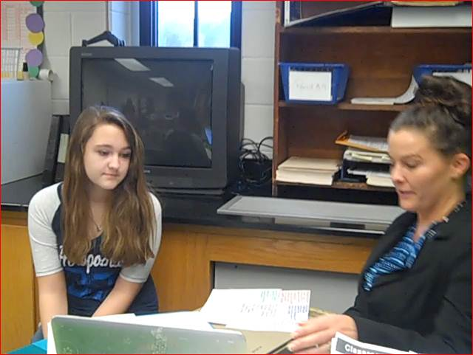
Teacher and Student One-to-One Conferencing with CDT Results: Example Two
21
Notes:
Notes for Trainer:
Go to eDIRECT site: https://pa.drcedirect.com. Click on Documents in the left side bar. Under Administration, select Classroom Diagnostic Tools 2013-2014. Under Document Type, dropdown to Professional Development. Find the following:
Video 3 - Emily and Teacher
One-to-One Conferencing Activity: Watch the video. Take notes on Module 4 graphic organizer for note taking. What were the signs of feedback? What opportunities were missed?
Discuss as a Table. Discuss as a group

Slide 22
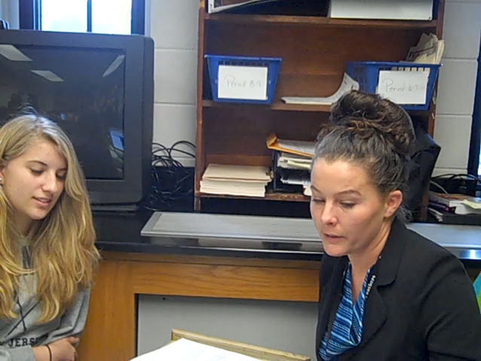
Teacher and Student One-to-One Conferencing with CDT Results:
Example Three
22
Notes:
Notes for Trainer:
Go to eDIRECT site: https://pa.drcedirect.com. Click on Documents in the left side bar. Under Administration, select Classroom Diagnostic Tools 2013-2014. Under Document Type, dropdown to Professional Development. Find the following:
Video 4 - Helena and Teacher
One-to-One Conferencing Activity: Watch the video. Take notes on Module 4 graphic organizer for note taking. What were the signs of feedback? What opportunities were missed?
Discuss as a Table. Discuss as a group

Slide 23
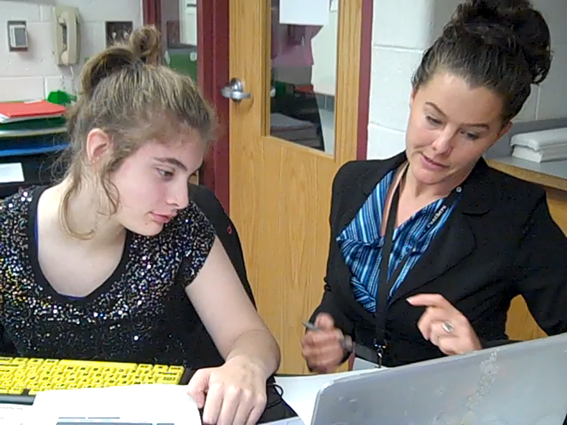
Teacher and Student One-to-One Conferencing with CDT Results:
Example Four
23
Notes:
Notes for Trainer:
Go to eDIRECT site: https://pa.drcedirect.com. Click on Documents in the left side bar. Under Administration, select Classroom Diagnostic Tools 2013-2014. Under Document Type, dropdown to Professional Development. Find the following:
Video 6 - Carly and Teacher
One-to-One Conferencing Activity: Watch the video. Take notes on Module 4 graphic organizer for note taking. What were the signs of feedback? What opportunities were missed?
Discuss as a Table. Discuss as a group.

Slide 24
In Closing…
“Learning is not always pleasurable and easy; it requires over-learning at certain points, spiraling up and down the knowledge continuum, building a working relationship with others in grappling with challenging tasks – herein lies a major link between challenge and feedback, two of the essential ingredients of learning.” (Hattie, 2012)
“The greater the challenge, the higher the probability that one seeks and needs feedback, but the more important it is that there is a teacher to provide feedback and to ensure that the learner is on the right path to successfully meet the challenges.” (Hattie, 2012)
“The most powerful single modification that enhances achievement is feedback.” (Hattie, 1992)
24
Notes:
Notes for Trainer:
Refer to a table to chorally read Hattie, 2012 The greater the challenge….
Trainer read second Hattie, 2012 Learning is not….
Refer to a table to chorally read Hattie, 1992 The most powerful….

